Slide 1

Blockchain-Based Vehicle Registration and Ownership Management System
IN 2900(IT)- Troyrangers
Faculty of Information Technology
University Of Moratuwa
2022

Slide 2





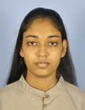
Team Members
204047J | Dissanayake D.M.B.M
204074M | Herath P.A.U.D
204087F | Jayathilaka P.H.P
204150T | Pathirana S.P.S.N
204179N | Rathnayaka A.M.D.B

Slide 3


Dr. A.L.A.R.R. Thanuja
Department of Computational Mathematics
University of Moratuwa
Supervisor
Mr. H.M.A. Bandara
B.Sc. in Eng (Electrical and Electronic)
M.Sc. in Computer Science
Consultant - Crede Technologies
Mentor

Slide 4



Problem in brief
Security issue in vehicle ownership registration

Slide 5

Background & Motivation
This project is on digitizing real-world objects, specifically vehicles, for the purpose of changing their ownership online.
This has not been done before and requires the development of a new system.

Slide 6


Aim
Develop a system for registering and transferring vehicle ownership from one person to another in a secure manner with the use of Blockchain Technology.

Slide 7

Objectives
Study the problem of the registering and the transferring vehicle ownership from one person to another through documentation.
Facilitate digitizing the system of registering and transferring vehicle ownership from one person to another.
Create the ability to generate a digital id for verifying person and vehicle identity.
Design the appropriate system including all user requirements.
Develop the system for solving the problem.

Slide 8

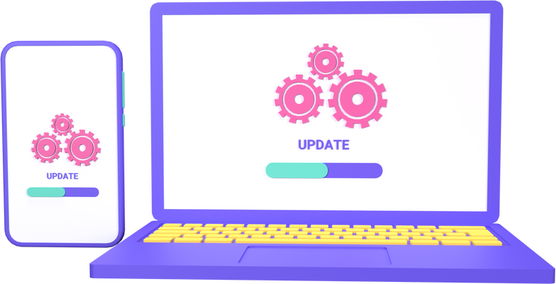
Existing software
Vehicle Registration and Information Management using Blockchain-based Distributed Ledger from Bangladesh Perspective
Sandbox
OpenSea

Slide 9

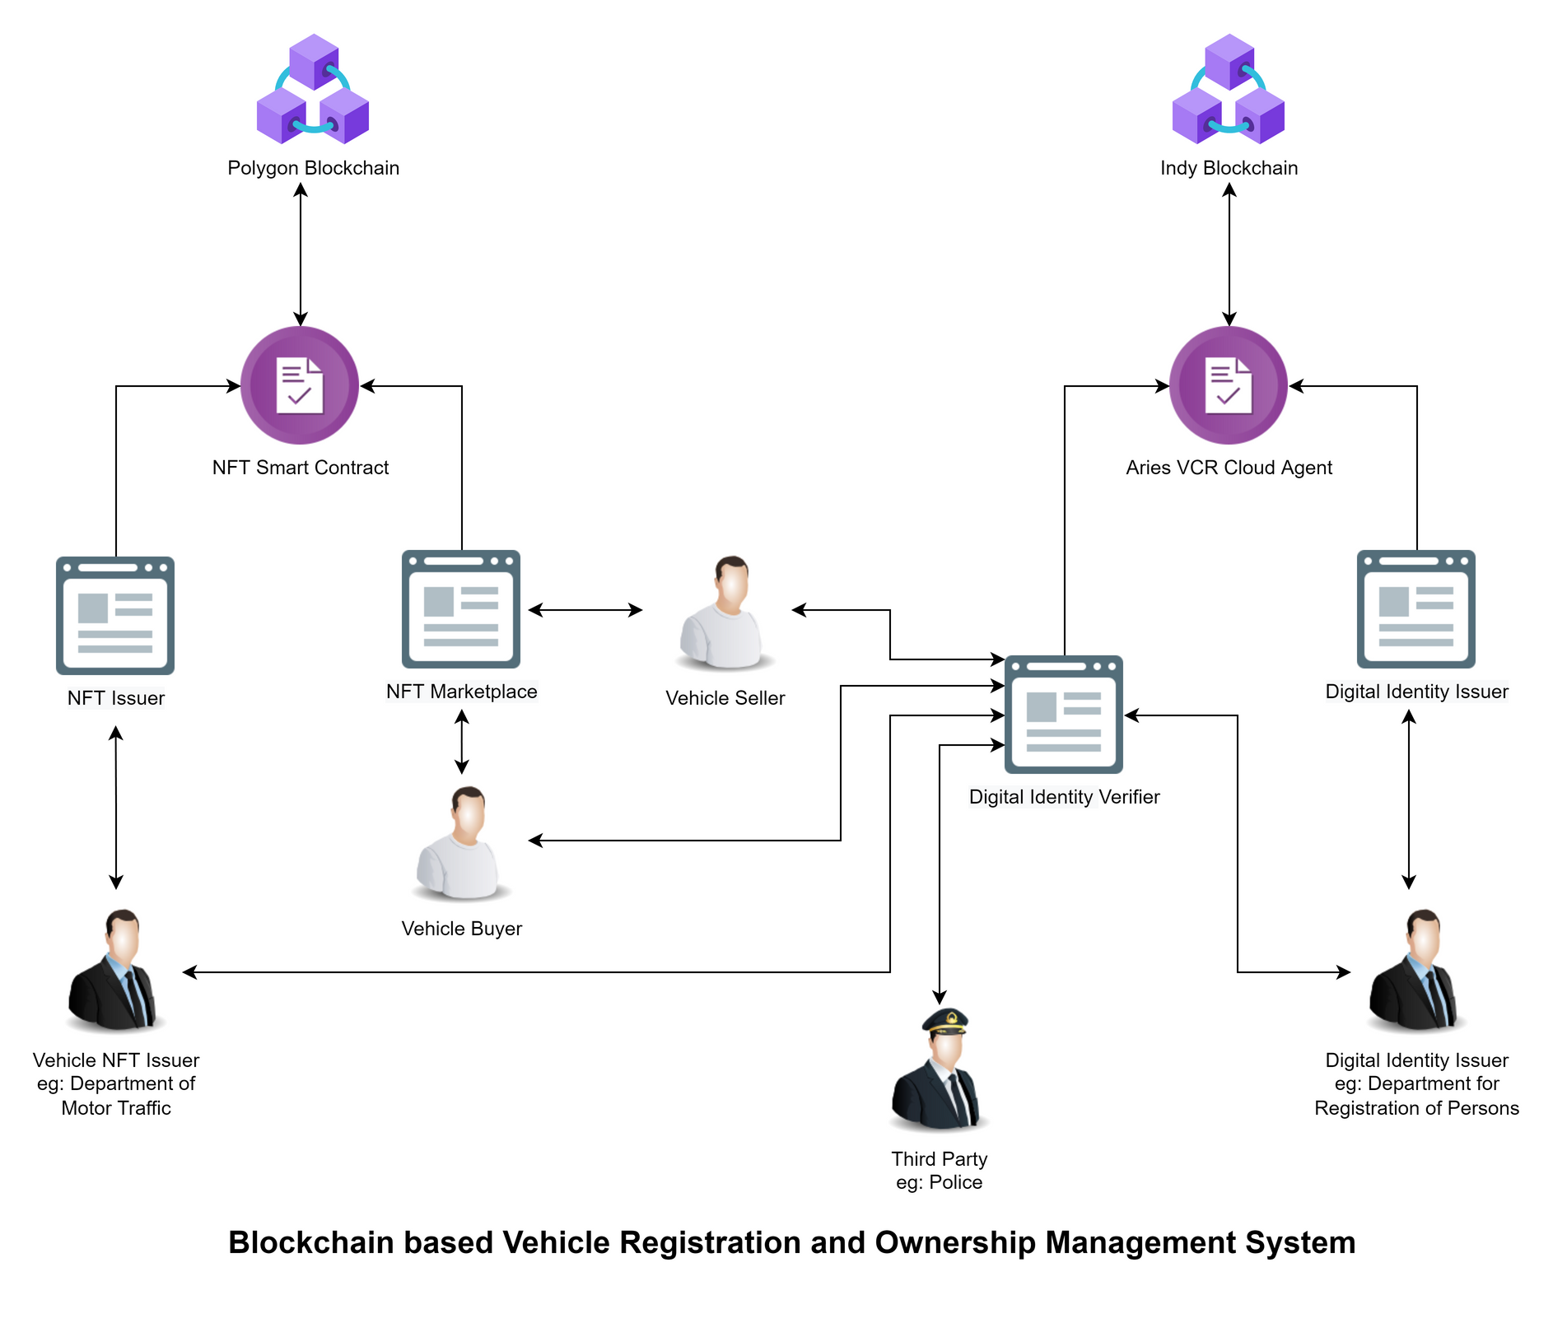
Proposed
Solution

Slide 10




Web 2 Technologies
ReactJs
NextJs
React Native
DJango

Slide 11
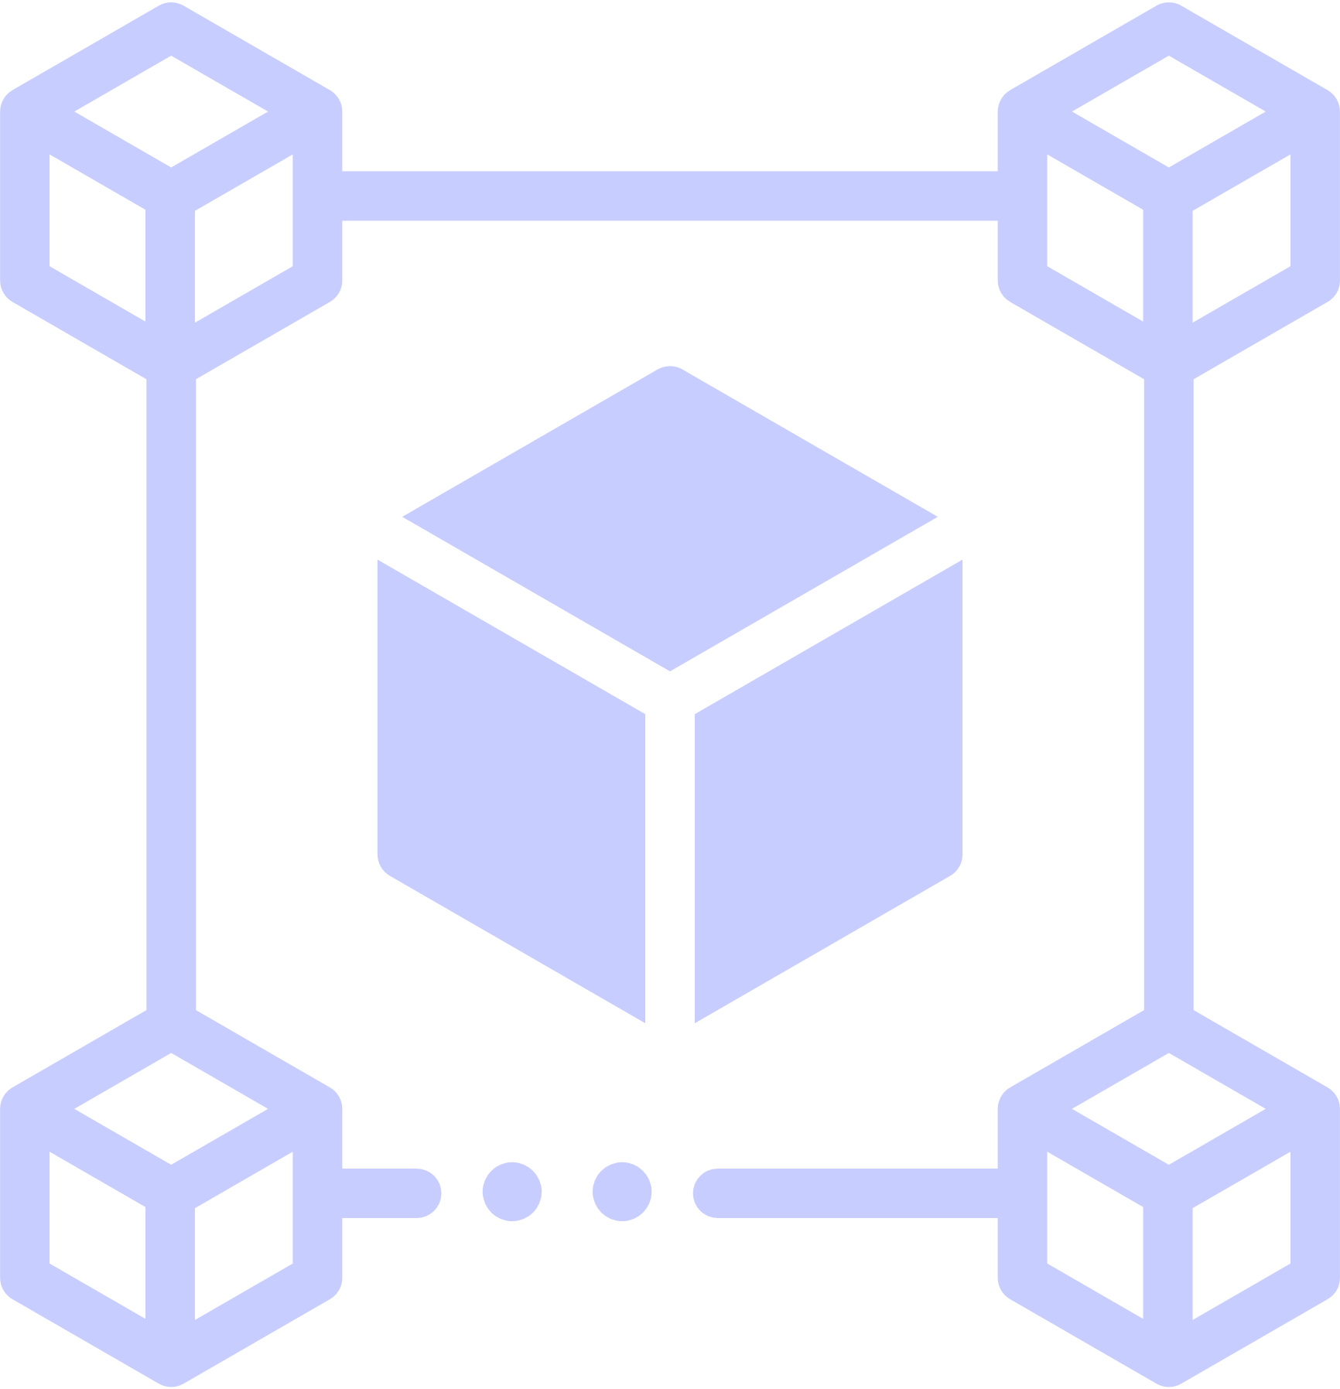



Web 3 Technologies
Blockchain
Aries Cloud Agent Python
MetaMask Wallet

Slide 12



DevOps Technologies
Docker
Docker Compose

Slide 13

Our Approach
In our approach we discussed,
the users
inputs and outputs of the system
process to achieve our goal,
the software process model that we used

Slide 14


Software Process Model
Waterfall Model
Reasons
All requirements are clear.
Tight deadline
hard to communicate with customers always

Slide 15

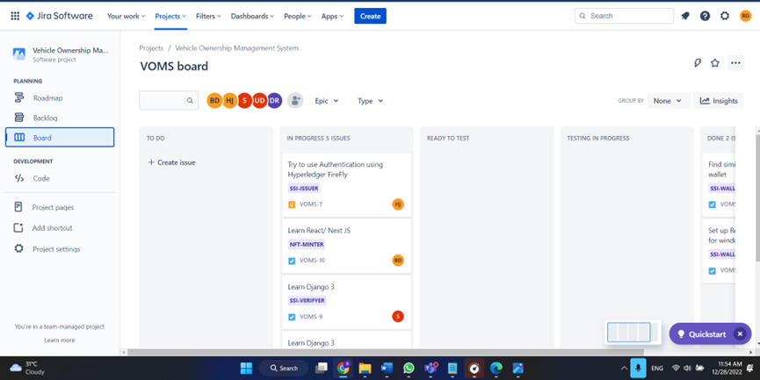
Project Management Plan
Jira

Slide 16
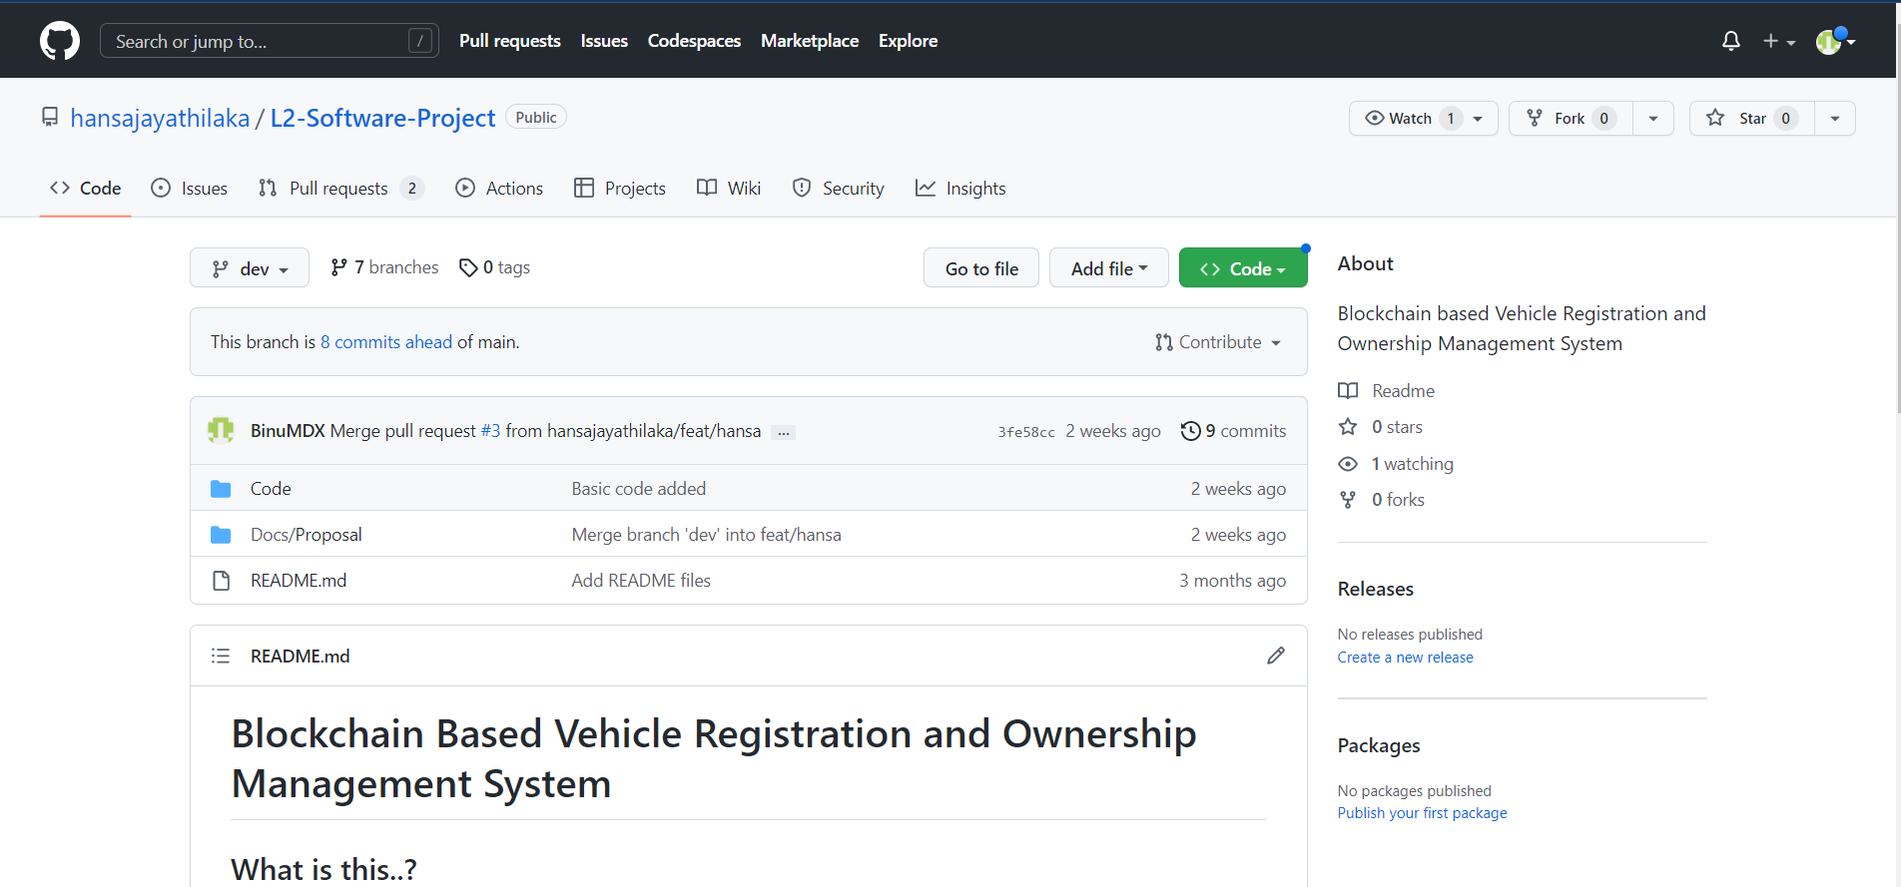

Version Control

Slide 17
Use Case Diagram
List of Diagrams
1
Class Diagram
2
Activity Diagram
3
Sequence Diagram
4
ER Diagram
5

Slide 18
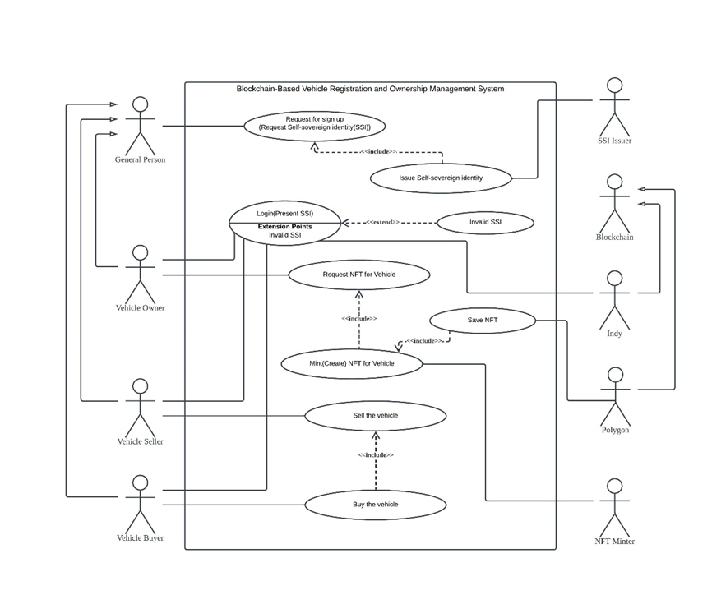
Use Case Diagram

Slide 19
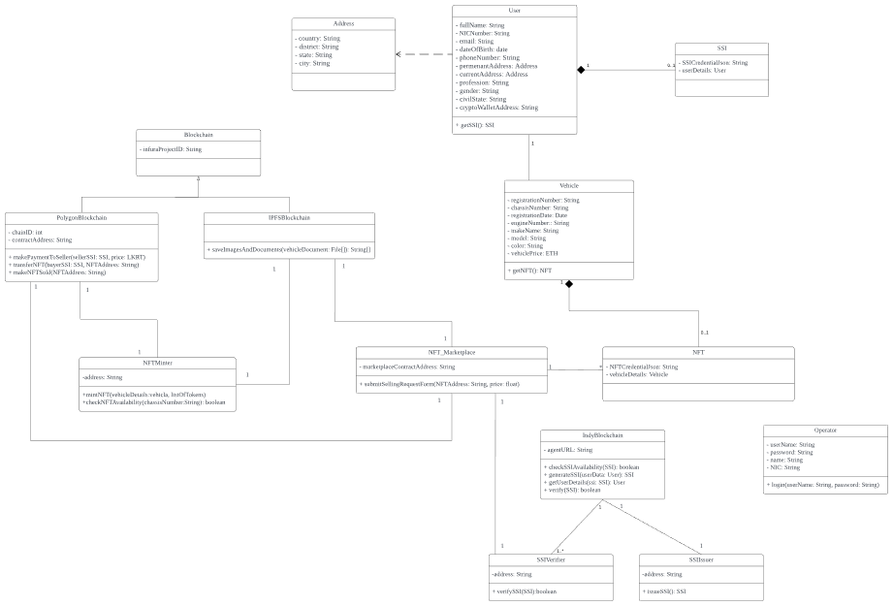
Class Diagram

Slide 20
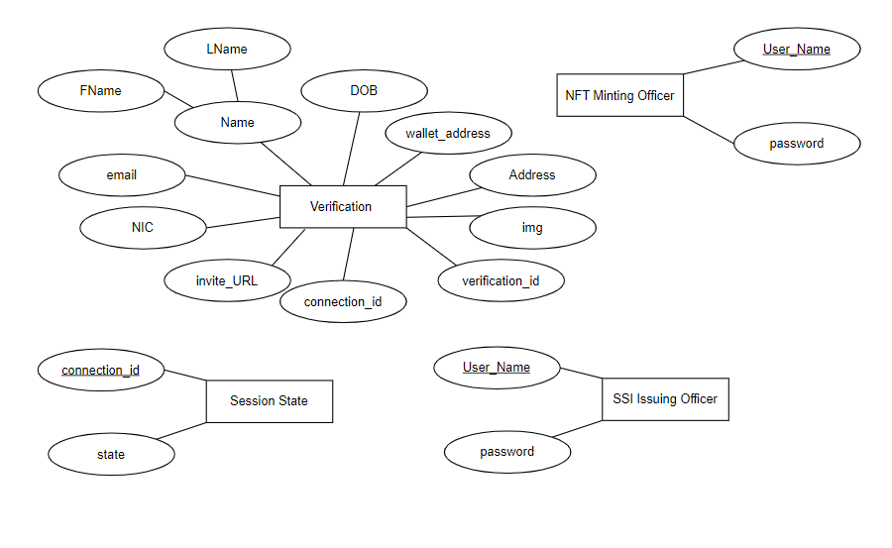
ER Diagram

Slide 21
Activity & Sequence Diagrams
https://lucid.app/lucidchart/fa4484e5-f54f-4c6f-b05c-64b92434f8c3/edit?invitationId=inv_093205f9-2a53-438c-a7ef-02ae2ab9ecf2&page=0_0#

Slide 22

Further Work
Introduce a new cryptocurrency to do transactions in the marketplace when selling and buying vehicles.
Add a verification with the database maintained by the government with vehicle details parallel to the manual verification process.

Slide 23


Individual Contribution

Slide 24
204047J - Dissanayake D.M.B.M
I was involved in drawing Use Case, ER, Class Diagram
Created Sequence and Activity Diagram for NFT Minter module
Responsible for preparing NFT Minter module

Slide 25
204074M - Herath P.A.U.D
I was involved in drawing Use Case, ER, Class Diagram
Created Sequence and Activity Diagram for Mobile SSI Wallet module
Responsible for preparing Mobile SSI Wallet module

Slide 26
204087F - Jayathilaka P.H.P
I was involved in drawing Use Case, ER, Class Diagram
Created Sequence and Activity Diagram for NFT Marketplace module
Responsible for preparing NFT Marketplace module

Slide 27
204150T - Pathirana S.P.S.N
I was involved in drawing Use Case, ER, Class Diagram
Created Sequence and Activity Diagram for SSI Verifier module
Responsible for preparing SSI Verifier module

Slide 28
204179N - Rathnayaka A.M.D.B
I was involved in drawing Use Case, ER, Class Diagram
Created Sequence and Activity Diagram for SSI Issuer module
Responsible for preparing SSI Issuer module

Slide 29
Thank you..

Slide 30
Q & A ?

